Slide 1
Modeling adaptive evolution

Slide 2
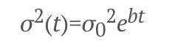
AC/DC model
BM, but with a declining rate parameter:
If b is negative, declining rates (i.e. Early burst)
If b is positive, increasing rates (late bursts, not identifiable from OU in ultrametric trees)

Slide 3
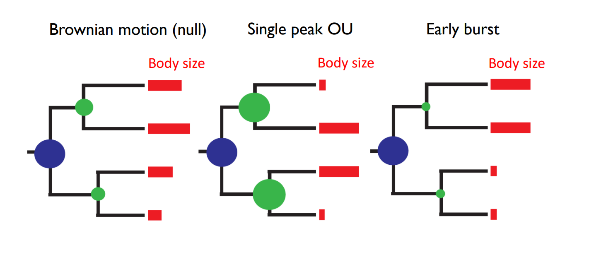
Early Burst -> Brownian Motion -> Ornstein-Uhlenbeck

Slide 4
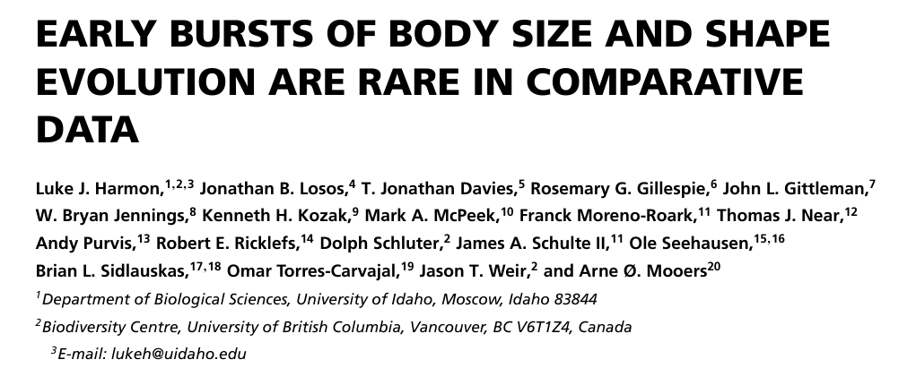
Early Burst -> Brownian Motion -> Ornstein-Uhlenbeck

Slide 5
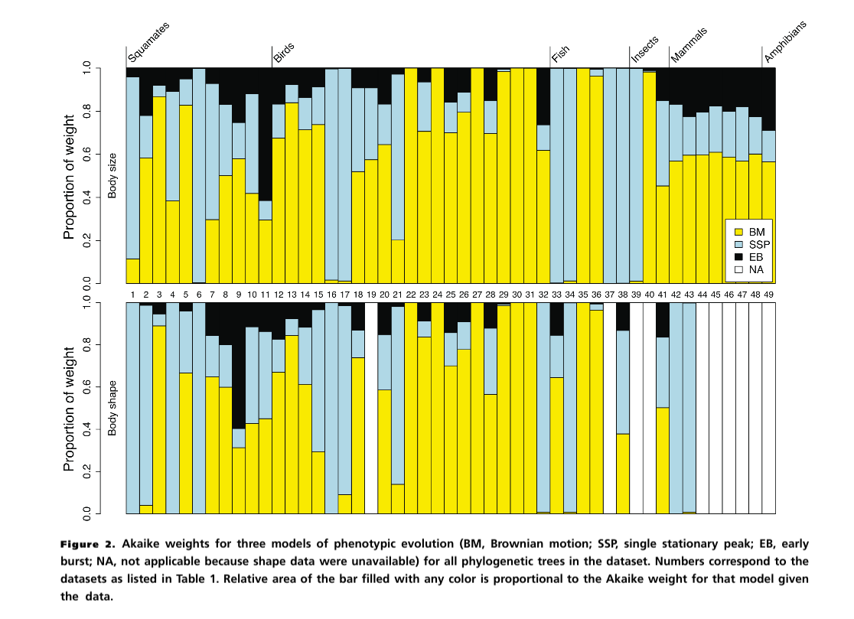
Early Burst -> Brownian Motion -> Ornstein-Uhlenbeck

Slide 6
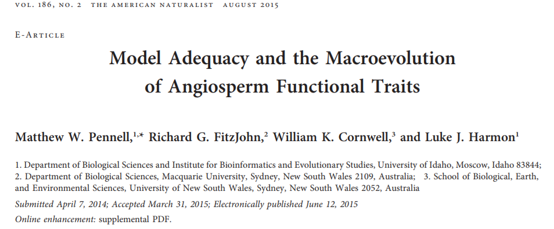
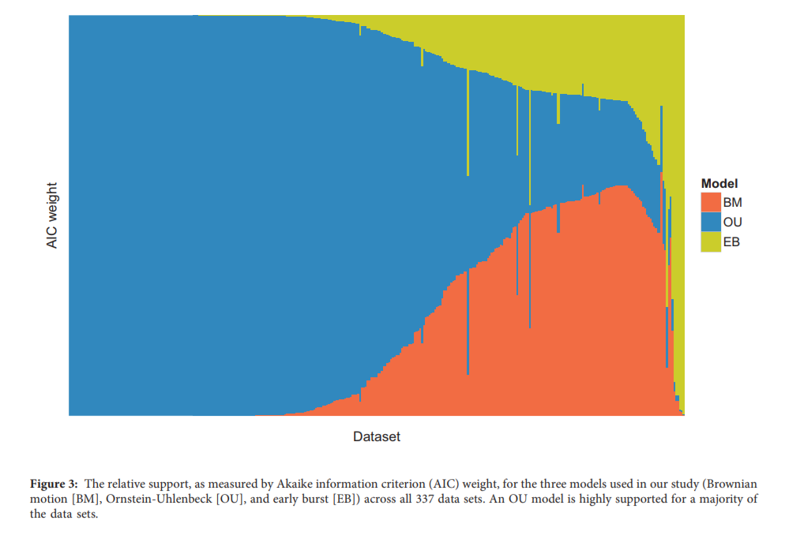

Slide 7
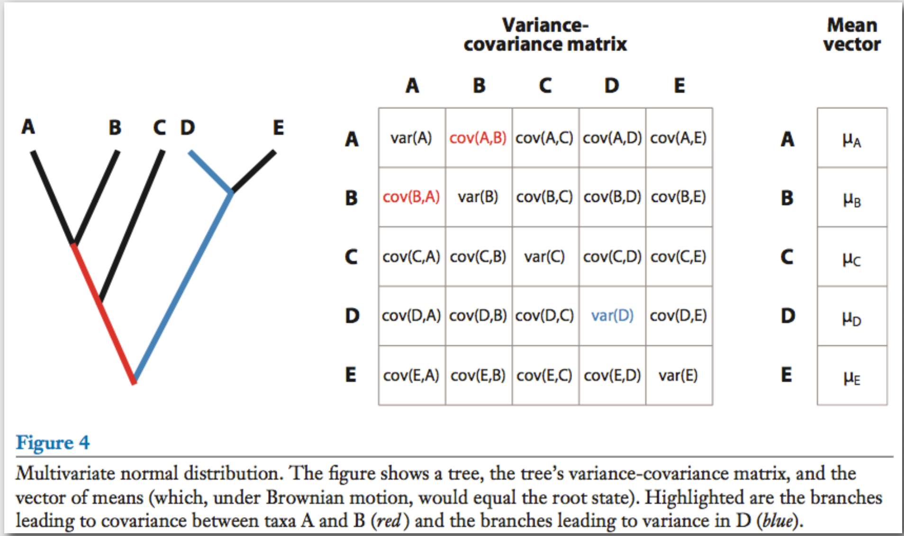

Slide 8
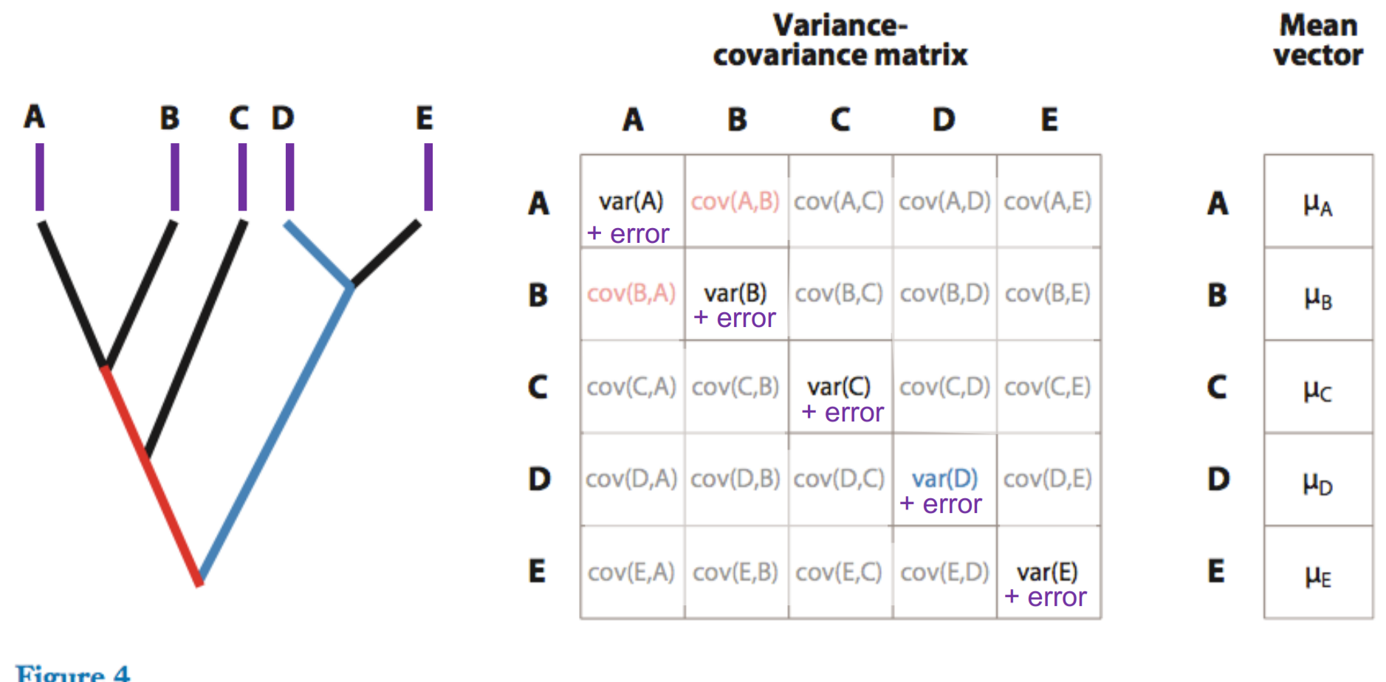
Why we must account for “measurement” error

Slide 9
EB BM OU WN
α = 0
halflife=∞
α
α =∞
halflife=0
OU models
High phylogenetic signal
No phylogenetic signal
ACDC model
(EB/OU)
-
+
0
Contrast
Node Height
test
Root Tip
Node age
Root Tip
Node age
Root Tip
Node age
Measurement error +
“Biological error”

Slide 10
PGLS + OU : Not a full OU model
Statistically, much like PGLS + Lambda
Appropriate only for “Allometric-type” relationships between predictor and response
OU model in variance, but not in mean (instantaneous adaptation)
Phylogenetic half-life with no predictors =
measure of phylogenetic signal
..................................... with predictors =
measure of REMAINING phylogenetic signal in residuals

Slide 11
Modeling adaptive shifts

Slide 12
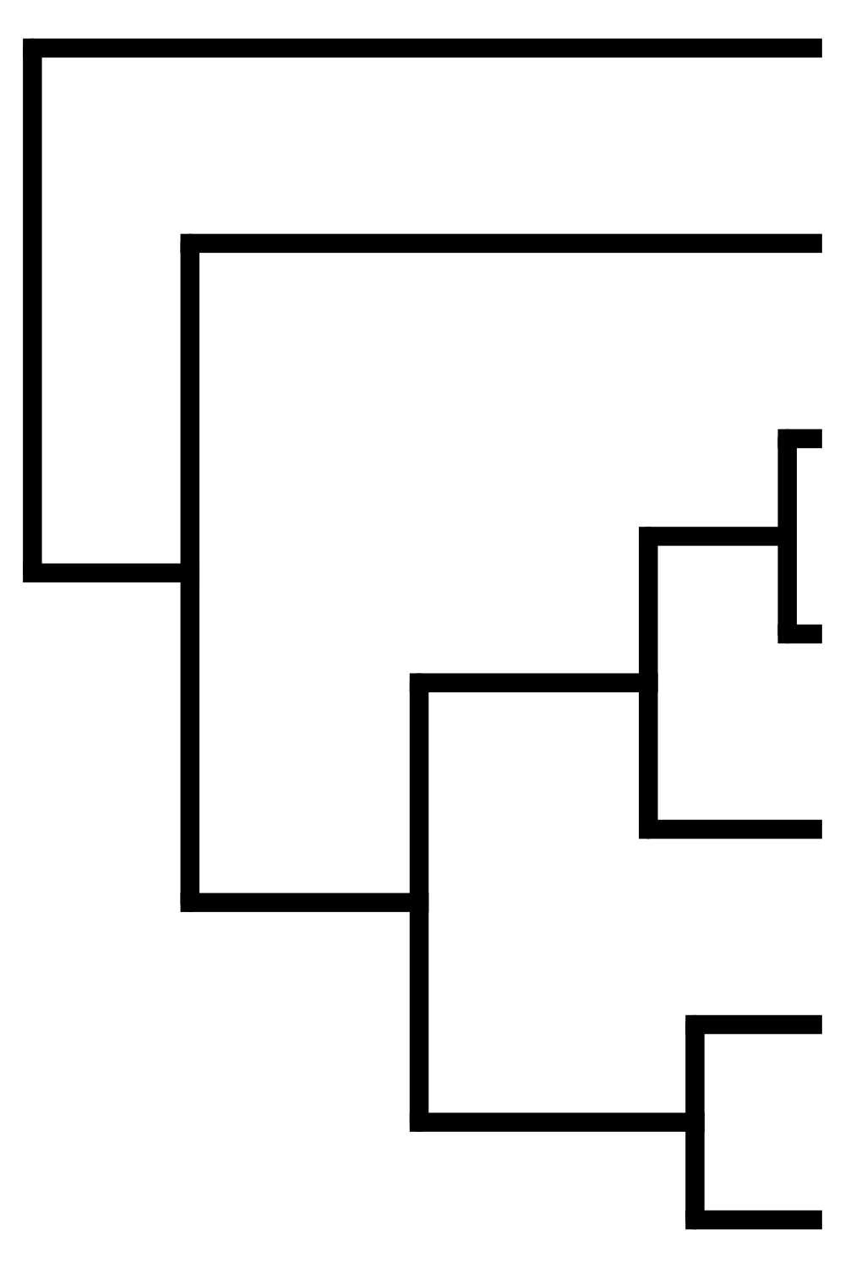
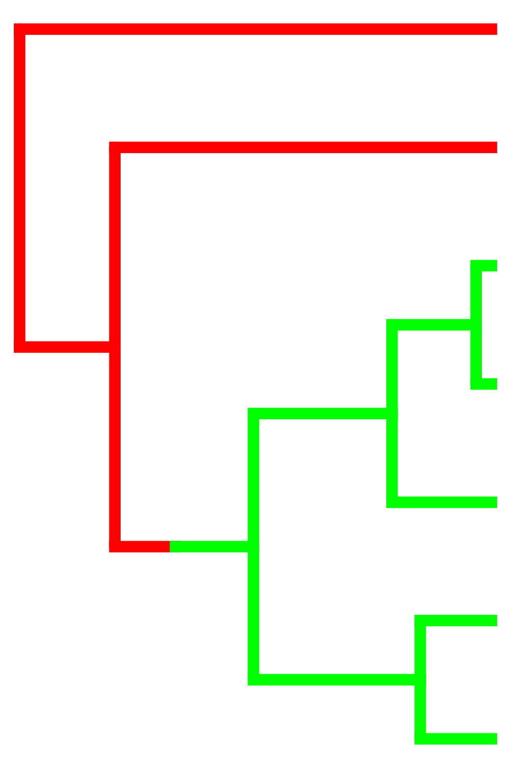
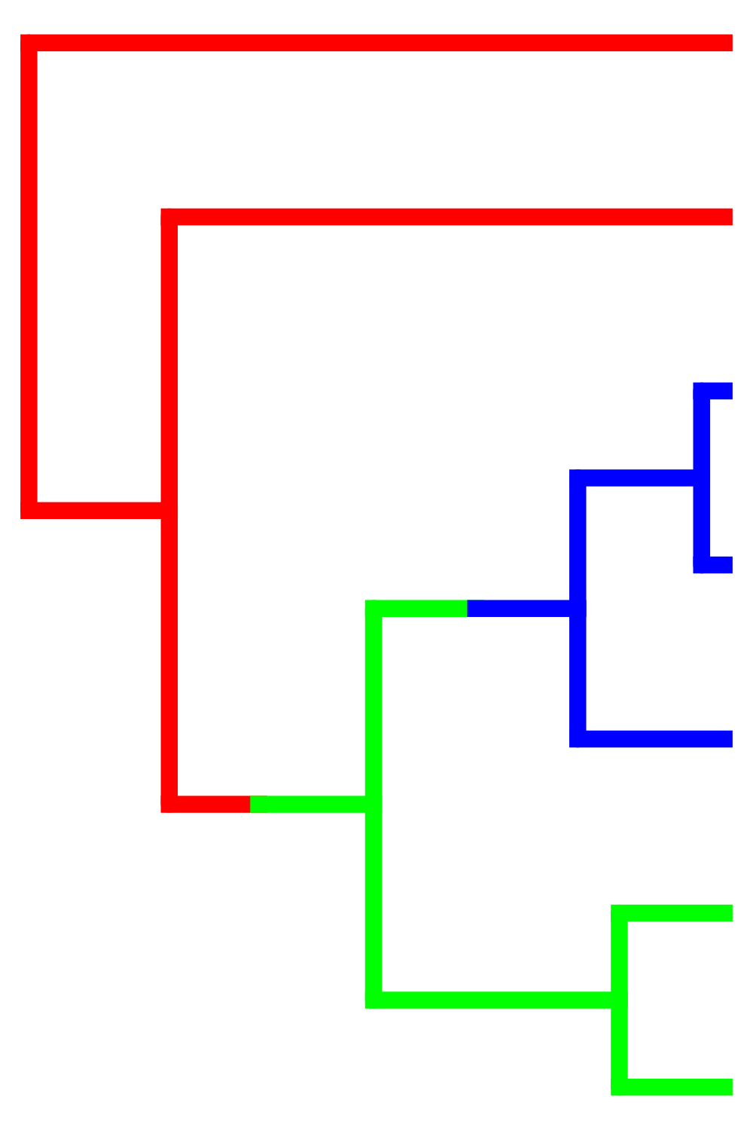







Slide 13
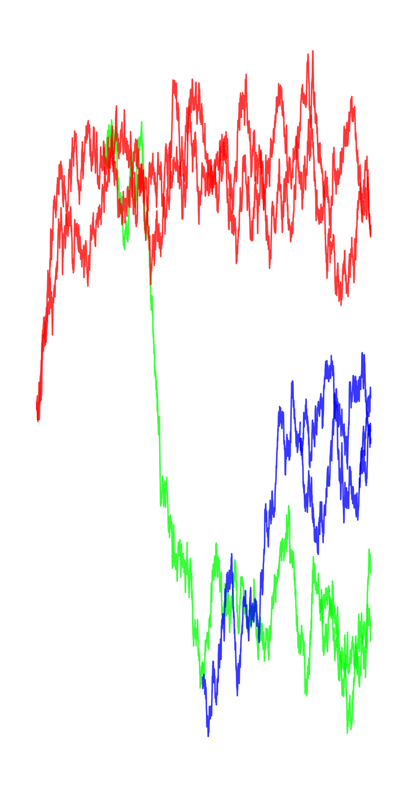
θ₁
θ₂
θ₃
Ornstein-Uhlenbeck
(Hansen 1997, Butler & King 2004)

Slide 14
Compare models
(e.g. by AIC)
Best Model
(Hansen 1997, Butler & King 2004)

Slide 15











Slide 17
Like phylogenetic models, lots of PCMs devoted to heterogeneity in the tempo & mode of evolution
Continuous traits:
BM (bayestraits, Auteur, BAMM, OUwie)
OU (bayou, l1ou, PhylogeneticEM)
Discrete traits
Hidden State Models (corHMM)
Diversification Models (BAMM, HiSSE, FiSSE)

Slide 18
You can change any parameter of the model (or the model itself) at the shift
Brownian Motion - σ²
Brownian Motion w/trend - σ², μ
OU - θ, σ², α
EB - σ², b
Example questions:
Does the rate of evolution change with habitat?
Does niche space expand on islands?
Do ectotherms have more constrained trait evolution than endotherms?
Is gene expression more constant early or late in cancer progression?
Are Anolis lizard ecomorphs convergent?

Slide 19
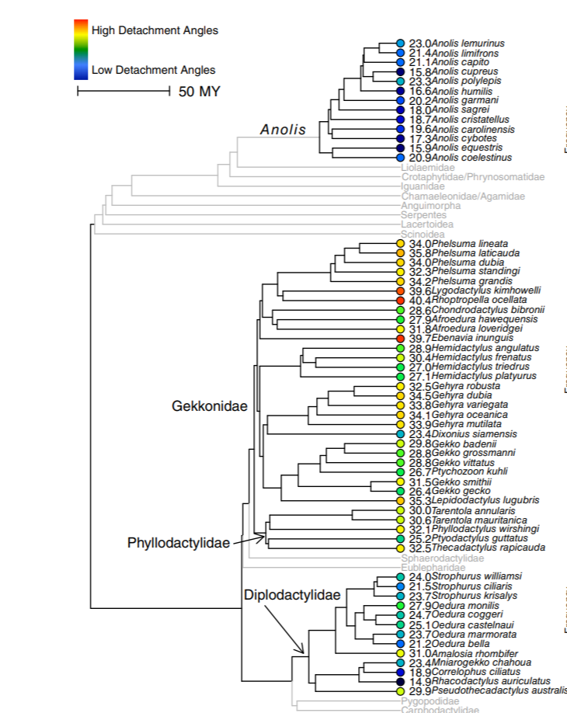
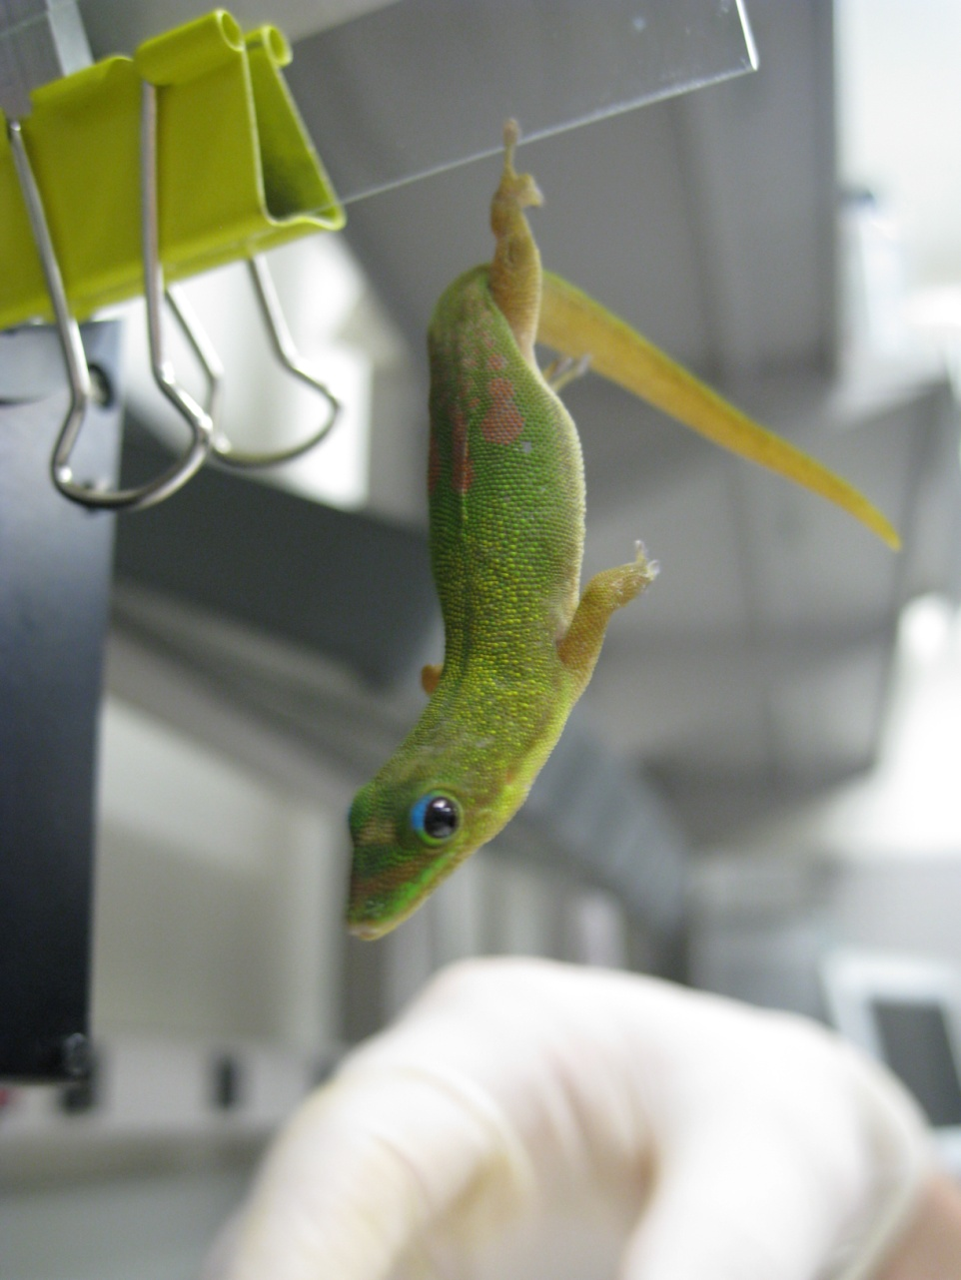

Do convergent pad-bearing lizards have similar evolutionary dynamics in functional performance?
Travis Hagey

Slide 20
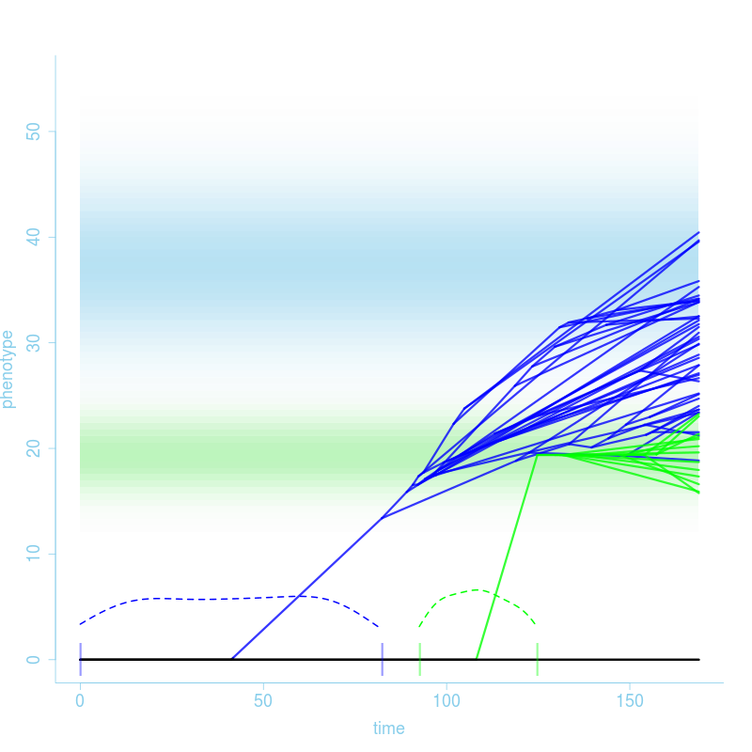
Hagey et al. 2017, Evolution
Geckos:
OU/BM w trend
Unconstrained
Anoles:
Strongly OU
Very constrained

Slide 21
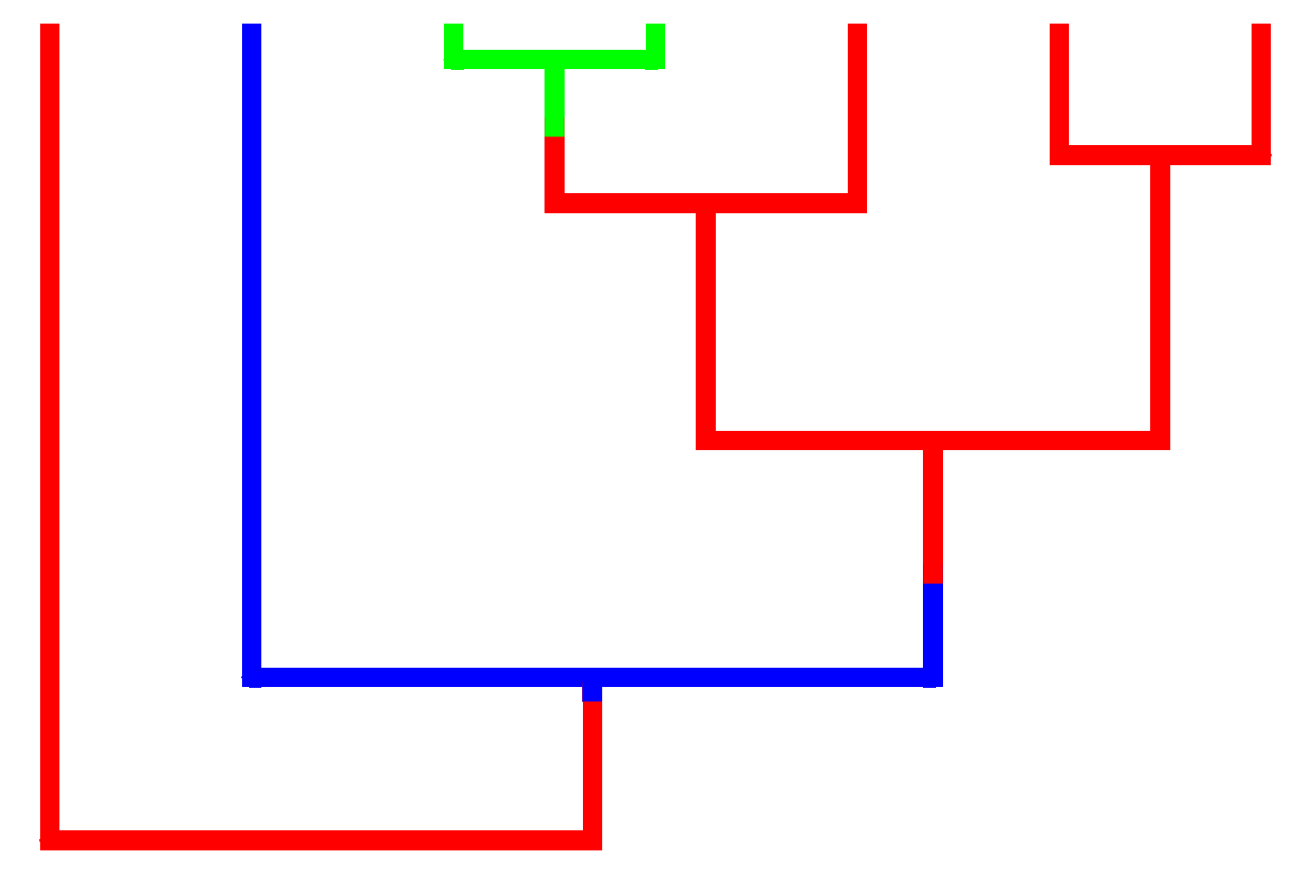

Uyeda & Harmon 2014

Slide 22
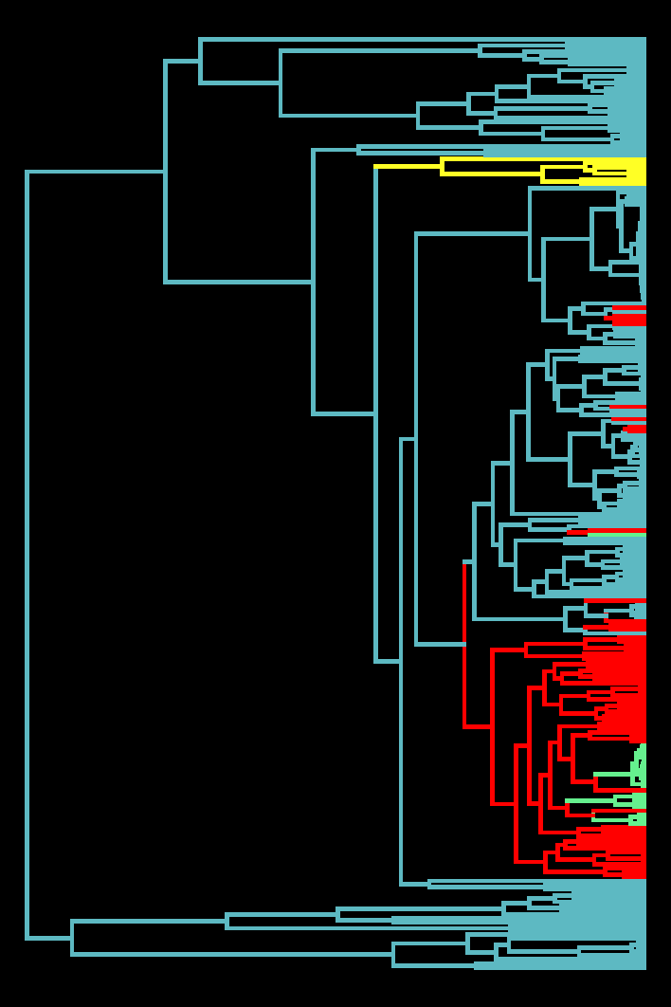




Turtles and Tortoises
(Jaffe et al. 2011)
Marine
Freshwater
Terrestrial
Island

Slide 23
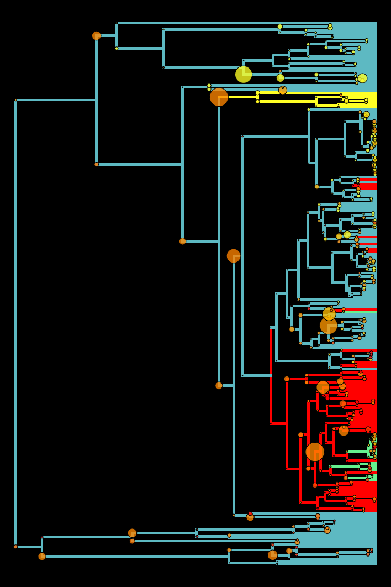

(Uyeda and Harmon, 2014)
Habitat Model
bayou Model
bayou $θ$: 8 – 167 cm
surface $θ$: 2.9x10⁻¹⁷⁰fm– 1.96x10⁴⁴ km

Slide 24
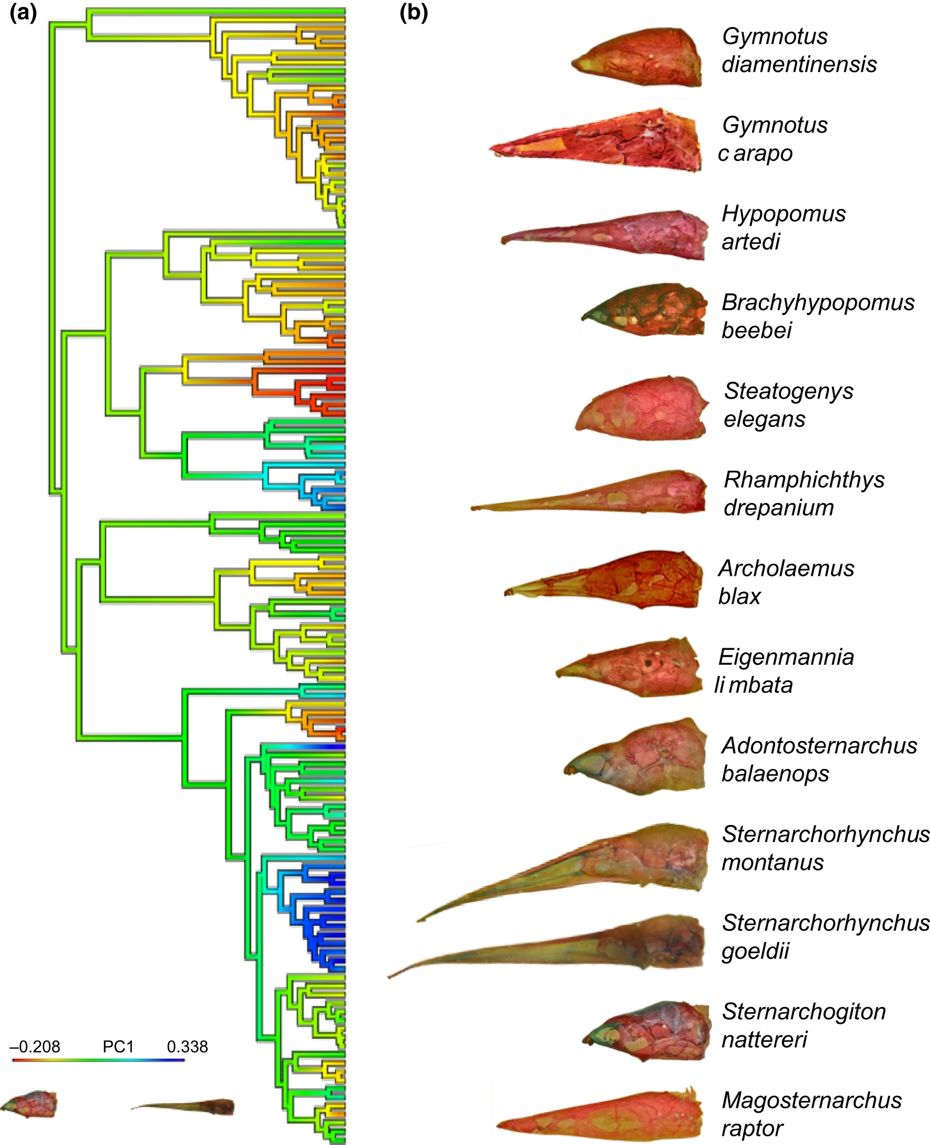
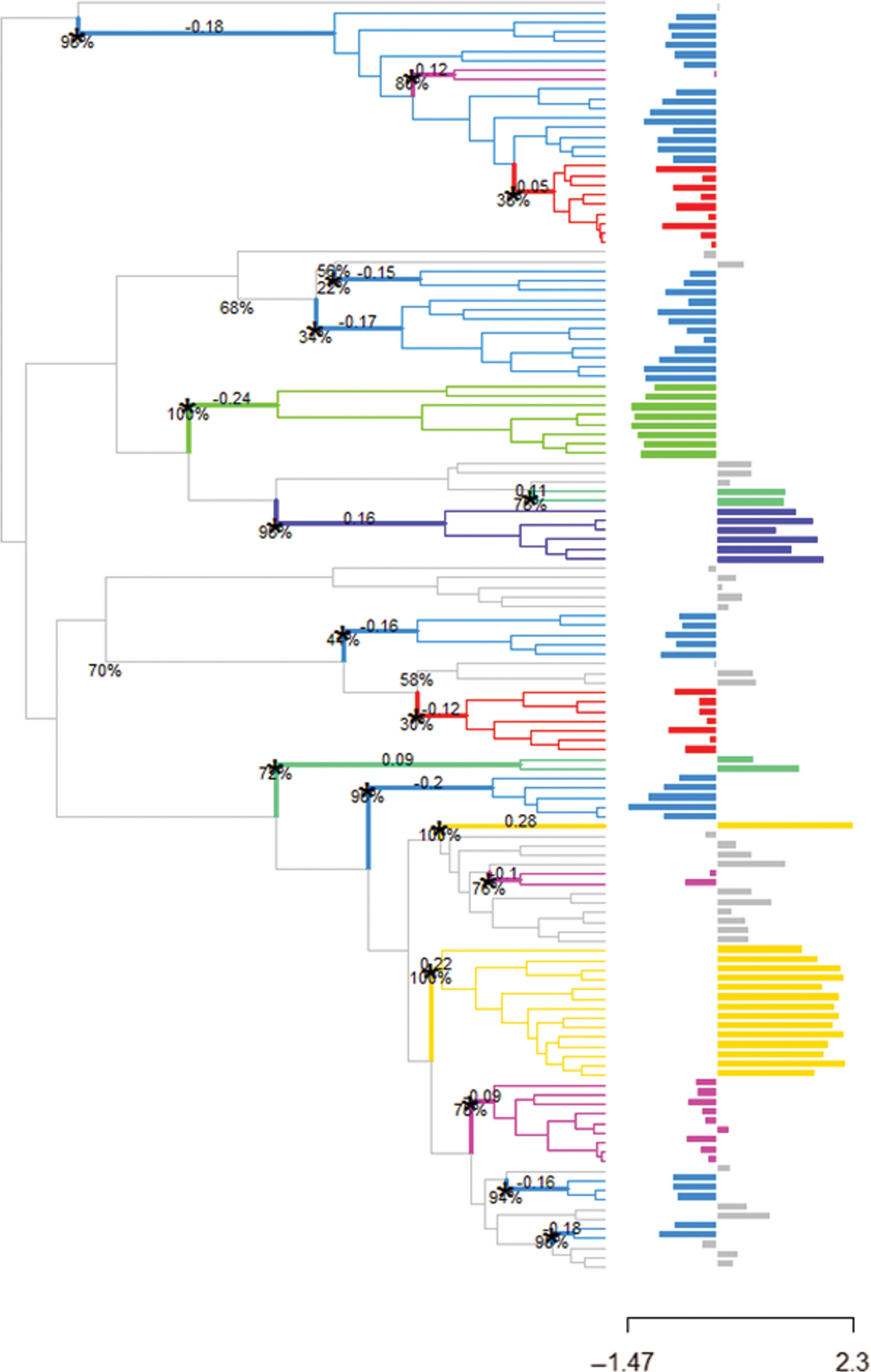
Evans, 2017 using l1ou

Slide 25
Shifts in Fossil Data: Unique Opportunities

Slide 26
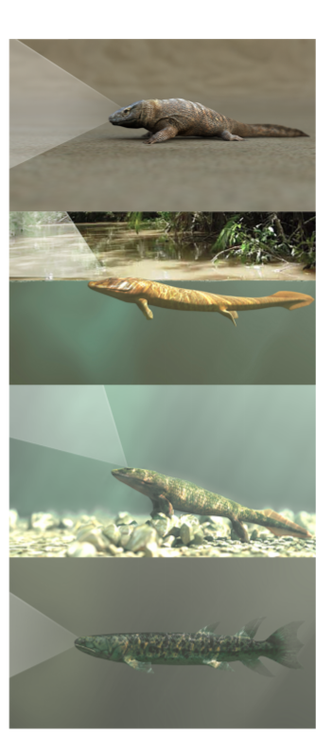
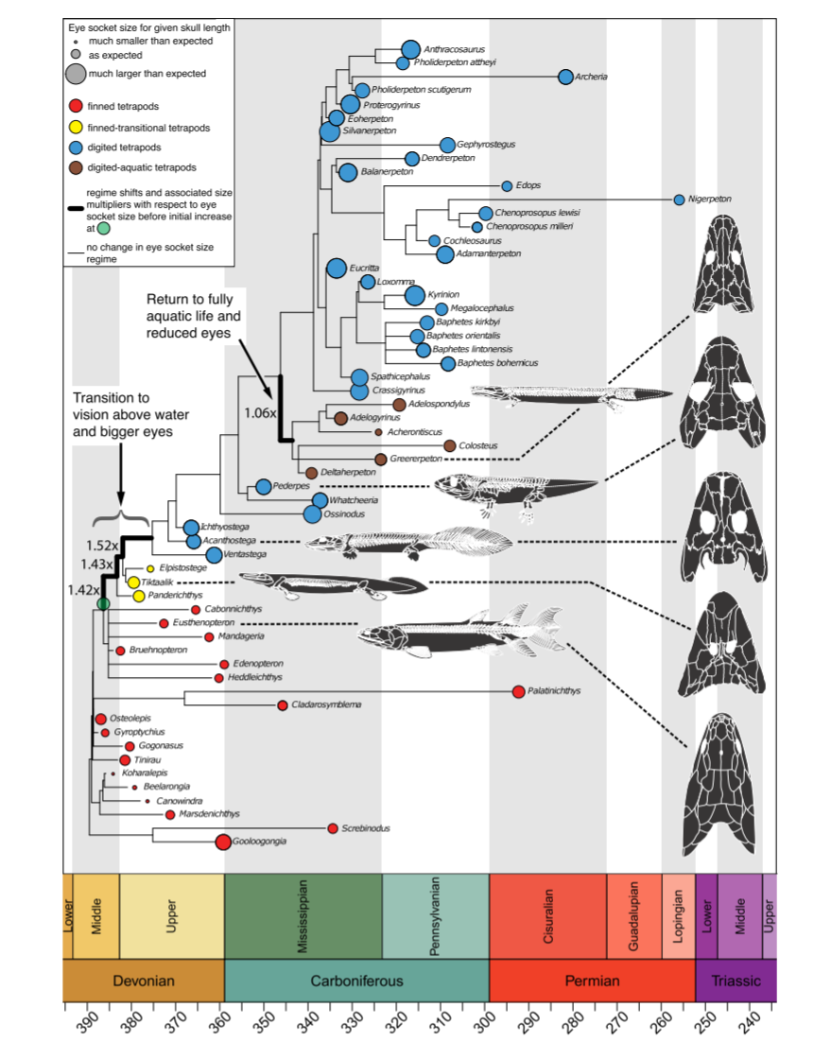
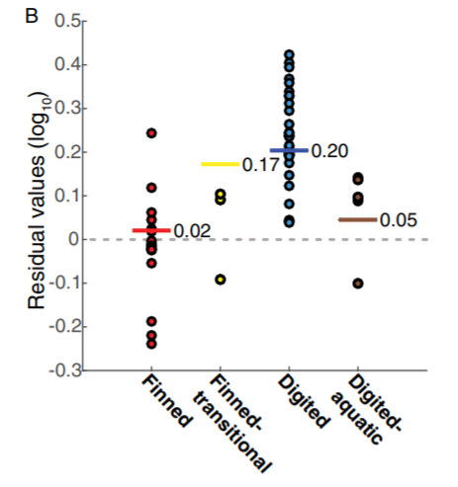
McIver et al. 2017, PNAS
halflife =
5.79 my

Slide 27
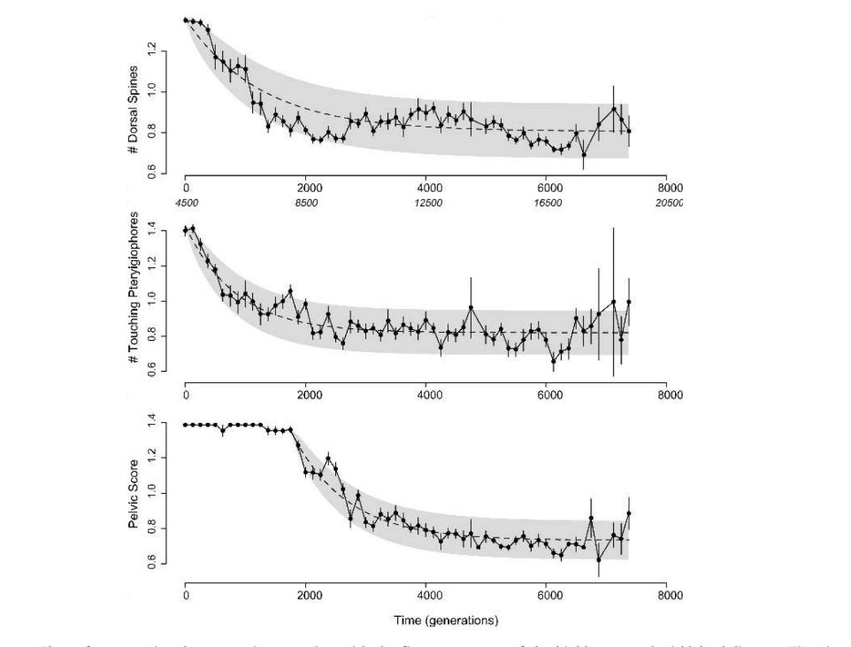
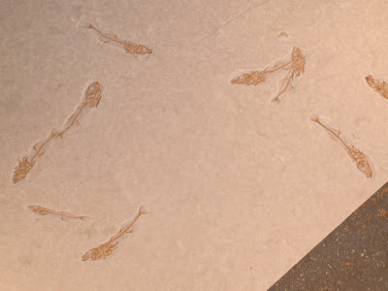
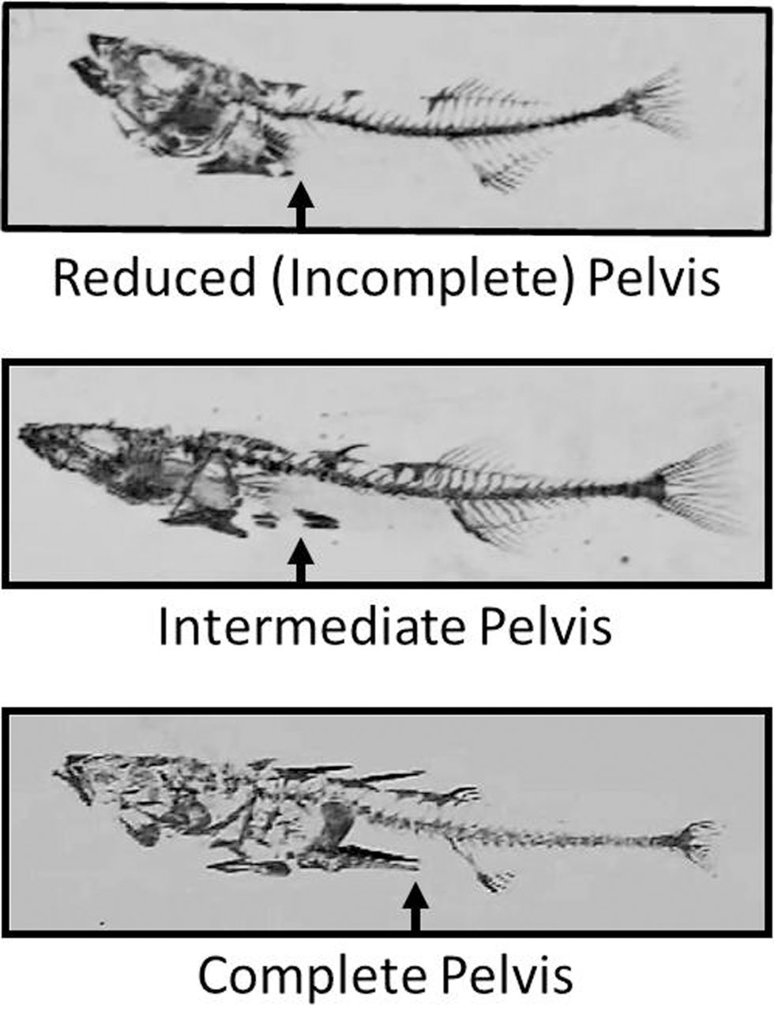
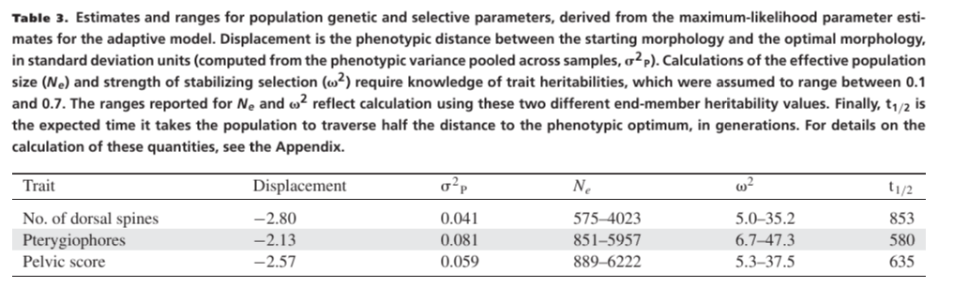
Hunt, Bell & Travis 2007

Slide 28
Strength of OU models: It looks like evolution! Parameters (could potentially) have biological meaning! Weaknesses: Statistical “bad dog”. Without constraints, can behave poorly.

Slide 29
But what if the optimum doesn't have discrete shifts? What if it moves continuously?

Slide 30
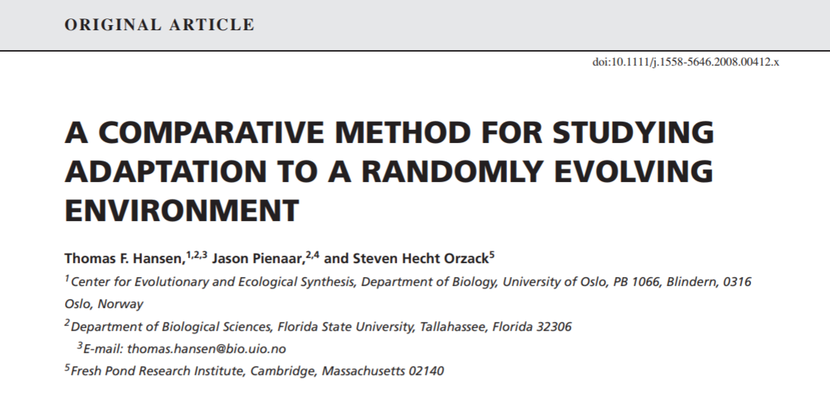
SLOUCH (Hansen, Pienaar & Orzack 2008)

Slide 31
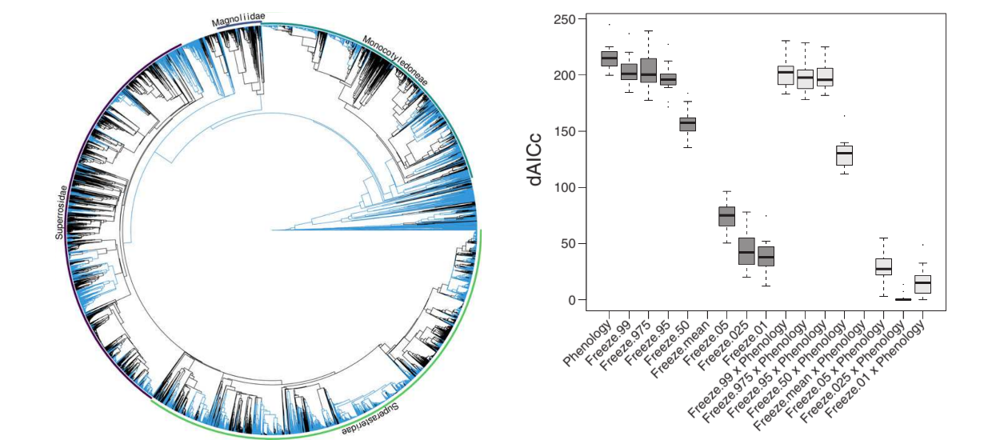
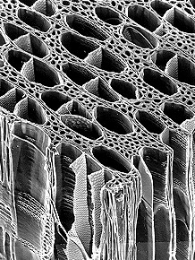
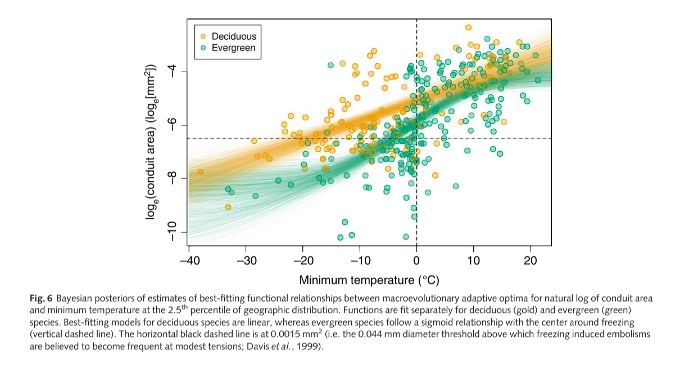

Slide 32
Method | Shift mapping | α & σ | Multivariate? | Optimum change | Inference approach | Predictors? | Convergent regimes?
OUCH (Butler & King 2004) | User hypotheses | Global | Yes | Discrete | Maximum Likelihood | Discrete regimes | Yes
Ouwie (Bealieu et al. 2012) | User hypotheses/ simmap | Regime-specific | No | Discrete | Maximum Likelihood | Discrete regimes | Yes
mvMORPH (Clavel 2015) | User hypotheses/ simmap | Global | Yes | Discrete | Maximum Likelihood | Discrete regimes | Yes
SLOUCH (Hansen et al. 2008) | None | Global | No | Brownian Motion | Maximum Likelihood | Continuously-evolving predictors | N/A
mvSLOUCH (Bartoszek et al. 2012) | None | Global | Yes | Brownian Motion/OU | Maximum Likelihood | Continuously co-evolving | N/A
SURFACE (Ingram & Mahler 2013) | Data driven (Stepwise AIC) | Global | Pseudo | Discrete | Maximum Likelihood | No | Yes
l1ou (Khabbazian et al. 2016) | Data driven (Lasso) | Global | No | Discrete | Maximum Likelihood | No | Yes
PhylogeneticEM (Bastide et al. 2018) | Data driven (Expectation maximization) | Global | Yes | Discrete | Maximum Likelihood | No | Yes
Bayou (Uyeda & Harmon 2014) | Data driven (RJMCMC) | Global | No | Discrete + | Bayesian | Regression framework | Not with RJMCMC

Slide 33
Overwhelmed? Take-home:
Lots of variations on a basic model (OU)
Models where everything vary -> Probably too complicated to fit to real data!
How you can simplify the model with what you KNOW.
Choose software that tests YOUR hypothesis and lets you incorporate YOUR knowledge

Slide 34
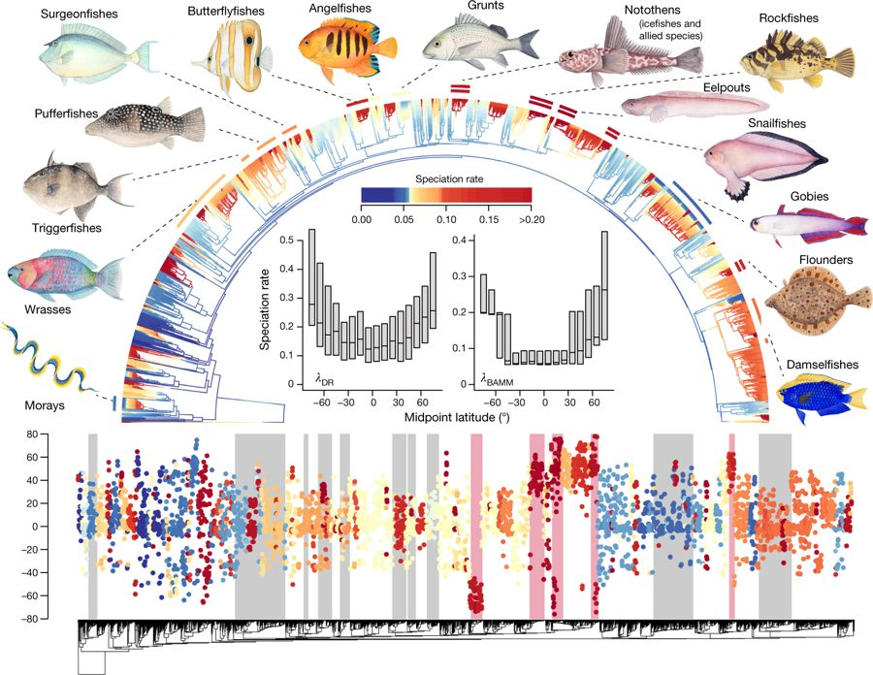
Similar models for Diversification: BAMM (Rabosky 2014)
Rabosky et al. 2018, Nature

Slide 35
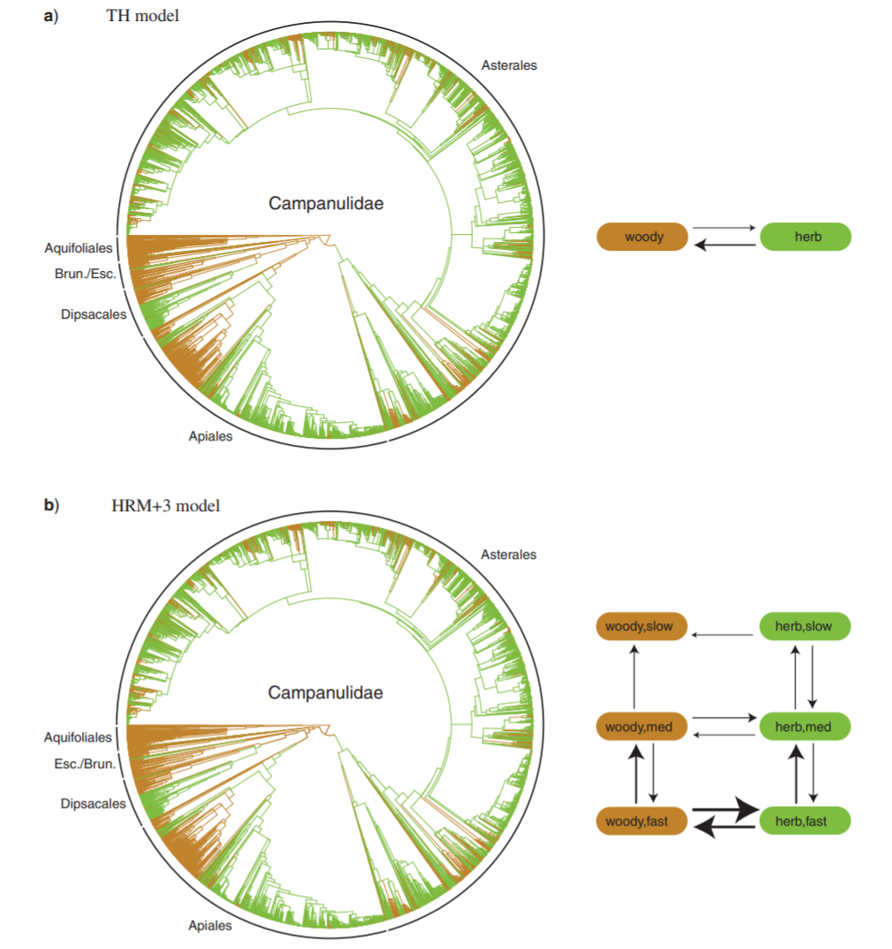
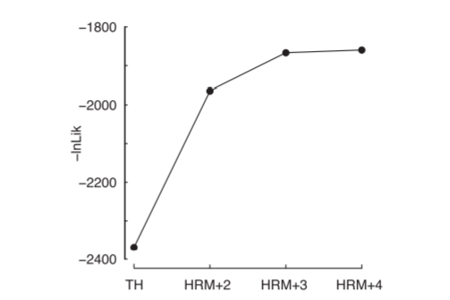
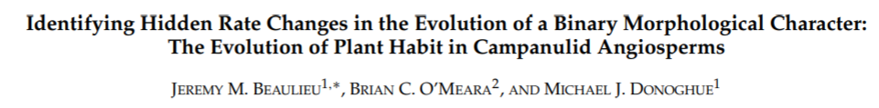
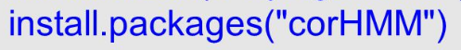
Shifts in Discrete Character Data: Hidden State Models

Slide 36
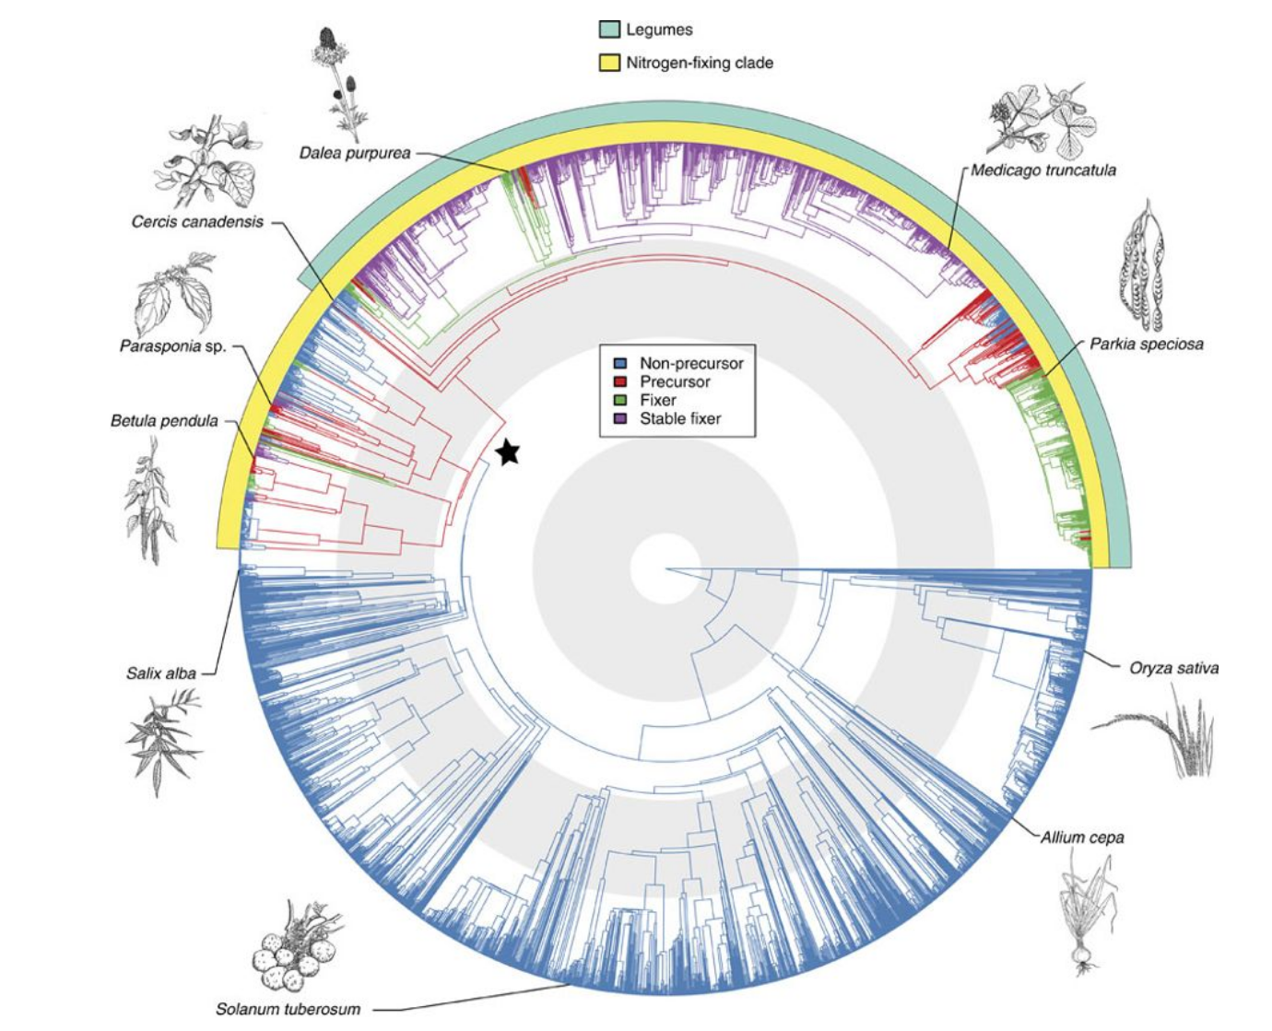
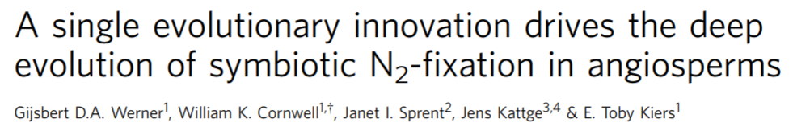

Slide 37
A word about Ancestral State Reconstruction...

